Slide 1


Slide 2
Winter of Xamarin
Vishesh Oberoi
Technical Evangelist, Microsoft
@ovishesh visho@microsoft.com

Slide 3

Mobile first + Cloud first

Slide 4
Any developer Any app Any platform

Slide 5
Any developer Any app Any platform
VISUAL STUDIO
ASP.NET
AZURE LINUX VM
VISUAL STUDIO CODE
C#
iOS DEVICE
XAMARIN STUDIO
C++
AZURE WINDOWS VM
EMACS
NODE.JS
ANDROID DEVICE
VIM
PYTHON
AZURE CONTAINER SERVICE
VISUAL STUDIO
HTML/JS
WINDOWS DEVICE
VISUAL STUDIO CODE
ASP.NET
AZURE WEB APP
XAMARIN STUDIO
C#
AZURE LINUX VM
EMACS
C++
iOS
DEVICE
VIM
NODE.JS
AZURE WINDOWS VM
PYTHON
ANDROID DEVICE
HTML/JS
AZURE CONTAINER SERVICE
WINDOWS DEVICE
AZURE WEB APP

Slide 6
Any developer Any app Any platform
ASP.NET
AZURE LINUX VM
VISUAL STUDIO
C#
iOS DEVICE
VISUAL STUDIO CODE
C++
AZURE WINDOWS VM
XAMARIN STUDIO
NODE.JS
ANDROID DEVICE
EMACS
PYTHON
AZURE CONTAINER SERVICE
VIM
HTML/JS
WINDOWS DEVICE
VISUAL STUDIO
ASP.NET
AZURE WEB APP
VISUAL STUDIO
ASP.NET
AZURE WEB APP
VISUAL STUDIO CODE
C#
AZURE LINUX VM
XAMARIN STUDIO
C++
iOS
DEVICE
EMACS
NODE.JS
AZURE WINDOWS VM
VIM
PYTHON
ANDROID DEVICE
HTML/JS
AZURE CONTAINER SERVICE
WINDOWS DEVICE
AZURE WEB APP

Slide 7
Any developer Any app Any platform
VISUAL STUDIO
AZURE LINUX VM
VISUAL STUDIO CODE
iOS DEVICE
XAMARIN STUDIO
AZURE WINDOWS VM
EMACS
ASP.NET
ANDROID DEVICE
VIM
C#
AZURE CONTAINER SERVICE
VISUAL STUDIO
C++
WINDOWS DEVICE
VISUAL STUDIO
CODE
NODE.JS
AZURE WEB APP
VISUAL STUDIO CODE
NODE.JS
AZURE WEB APP
XAMARIN STUDIO
PYTHON
AZURE LINUX VM
EMACS
HTML/JS
iOS
DEVICE
VIM
ASP.NET
AZURE WINDOWS VM
C#
ANDROID DEVICE
C++
AZURE CONTAINER SERVICE
NODE.JS
WINDOWS DEVICE
PYTHON
AZURE WEB APP
HTML/JS

Slide 8
Any developer Any app Any platform
VISUAL STUDIO
AZURE LINUX VM
VISUAL STUDIO CODE
iOS DEVICE
XAMARIN STUDIO
AZURE WINDOWS VM
EMACS
ASP.NET
ANDROID DEVICE
VIM
C#
AZURE CONTAINER SERVICE
VISUAL STUDIO
C++
WINDOWS DEVICE
VISUAL STUDIO
C++
WINDOWS DEVICE
VISUAL STUDIO CODE
NODE.JS
AZURE WEB APP
XAMARIN STUDIO
PYTHON
AZURE LINUX VM
EMACS
HTML/JS
iOS
DEVICE
VIM
ASP.NET
AZURE WINDOWS VM
C#
ANDROID DEVICE
C++
AZURE CONTAINER SERVICE
NODE.JS
WINDOWS DEVICE
PYTHON
AZURE WEB APP
HTML/JS

Slide 9
Any developer Any app Any platform
AZURE LINUX VM
ASP.NET
iOS DEVICE
C#
AZURE WINDOWS VM
VISUAL STUDIO
C++
ANDROID DEVICE
VISUAL STUDIO CODE
NODE.JS
AZURE CONTAINER SERVICE
XAMARIN STUDIO
PYTHON
WINDOWS DEVICE
EMACS
HTML/JS
AZURE WEB APP
VIM
ASP.NET
AZURE LINUX VM
VISUAL STUDIO
C#
iOS DEVICE
VISUAL STUDIO
C#
iOS
DEVICE
VISUAL STUDIO CODE
C++
AZURE WINDOWS VM
XAMARIN STUDIO
NODE.JS
ANDROID DEVICE
EMACS
PYTHON
AZURE CONTAINER SERVICE
VIM
HTML/JS
WINDOWS DEVICE
AZURE WEB APP

Slide 10
Any developer Any app Any platform
AZURE LINUX VM
iOS DEVICE
AZURE WINDOWS VM
ASP.NET
ANDROID DEVICE
VISUAL STUDIO
C#
AZURE CONTAINER SERVICE
VISUAL STUDIO CODE
C++
WINDOWS DEVICE
XAMARIN STUDIO
NODE.JS
AZURE WEB APP
EMACS
PYTHON
AZURE LINUX VM
EMACS
PYTHON
AZURE LINUX VM
VIM
HTML/JS
iOS
DEVICE
VISUAL STUDIO
ASP.NET
AZURE WINDOWS VM
VISUAL STUDIO CODE
C#
ANDROID DEVICE
XAMARIN STUDIO
C++
AZURE CONTAINER SERVICE
EMACS
NODE.JS
WINDOWS DEVICE
VIM
PYTHON
AZURE WEB APP
HTML/JS

Slide 11

The Visual Studio Family
Best-in-class tools for every developer
Visual Studio
Visual Studio Code
Visual Studio Team Services
Microsoft Azure

Slide 12
OPERATION: REMOTE RESUPPLY

Slide 13
Architecting mobile apps

Slide 14
Silo approach
iOS
Android
Windows
Objective-C
Xcode
Java
Android Studio
C#
Visual Studio
No shared code • Many languages and development environments • Multiple teams
Notes:
Today if you look at all the different mobile development options you will find that in order to be successful in the mobile world you end having to learn different languages and framework… obj-c, java, c#, etc..
Which we also like to refer to sometimes as native mobile development.

Slide 15
What is Native?
Notes:
But lets try to demistfy what native development really mean.
What does it mean to be native? What does it mean to have a native app? What is this native thing? I thought what I had to do was learn obj c, java, etc..

Slide 16
?
?
?
Native UI
Native APIs
Native
performance
Notes:
Boil it down to 3 core things when building apps for our users, but also what we deserve as mobile developers.
We want to create a native UX and UI.. There is a reason why someone bought an iOS, Android or a Windows device.. They bought their phone of choice because they like the hardware and the software design, and they deserve to get a similar experience that is based on similar design principles. Need to get access to that native experience – to material design on Android and to what Apple is doing with their apps, and what we are doing with our Windows 10 development framework.
And as developers, we want access to the full power of the platform we are developing for, so when Android N came out, I want it there in my dev toolkit.. Access to hardware, etc. All the APIs with every iterative update
And I want the fastest experience.. Super fast, great performance
And also for us as developers when we are choosing the right framework for our cross-plat mobile development.

Slide 17
Silo approach
iOS
Android
Windows
Objective-C
Xcode
Java
Android Studio
C#
Visual Studio
No shared code • Many languages and development environments • Multiple teams
Notes:
But then if we go back to our traditional approach, I sometimes have/had to use Eclipse that I never wanted to open up, but you know it was that..
And then with that comes this work overload of maintaining three different code bases, have different CI pipelines, deployment strategies, etc.
And then we think about what if I just write some code that goes through a box and creates/spits out apps for me for all these platforms.

Slide 18
Write once, run anywhere
Lua
Javascript
Actionscript
HTML+CSS
App generator
Limited native API access • Slow performance • Poor user experience
Notes:
A lot of these frameworks are javascript, etc. – that go through some sort of app box and then give out apps for each of the platforms.
And then often, but mostly running in some sort of webview, etc.
Its not every framework, but then there are too many different js frameworks too, which one to use.. Etc.
And there is always some abstraction, because they were developing for the framework and not for the native experience.
Which is when there was a lot of bad rep for cross-plat development for quite a while because of these abstracted experiences. Because people were not getting the best experience, and the browser technologies were not the best too, but then that’s when we had Xamarin come along.

Slide 19
Xamarin’s unique approach
iOS C# UI
Android C# UI
Windows C# UI
Shared C# logic
Shared C# codebase • 100% native API access • High performance
Notes:
Build completely native apps across iOS, Android, Mac and Windows.

Slide 20
Windows APIs
Microsoft.Phone
Microsoft.Networking
Windows.Storage
Windows.Foundation
Microsoft.Devices
System.Net
System
System.IO
System.Linq
System.Xml
System.Data
System.Windows
System.Numerics
System.Core
System.ServiceModel
C#

Slide 21
iOS—100% API coverage
MapKit
UIKit
iBeacon
CoreGraphics
CoreMotion
System.Net
System
System.IO
System.Linq
System.Xml
System.Data
System.Windows
System.Numerics
System.Core
System.ServiceModel
C#
Notes:
Instead of running on the .net runtime its running on the mono runtime
They are not binaries, but are C# bindings that give you that native experience
That gives you the flexibility to build apps that have a massive shared code base.

Slide 22
Android—100% API coverage
Text-to-speech
ActionBar
Printing Framework
Renderscript
NFC
System.Net
System
System.IO
System.Linq
System.Xml
System.Data
System.Windows
System.Numerics
System.Core
System.ServiceModel
C#

Slide 23
Code sharing stats
iCircuit
Touch Draw
Android
iOS
Mac
Windows
Notes:
On average some of our developers share about 70% of code and sometimes it quite often goes up to 90%

Slide 24
Native performance
ARM BINARY
IL + JIT
.NET
.NET
AOT
.APP
Compile and Link
.APK
C#
C#
Runs natively
Runs natively
Bindings
Bindings
Xamarin.iOS does full Ahead Of Time (AOT) compilation to produce an ARM binary for Apple’s App Store.
Xamarin.Android takes advantage of Just In Time (JIT) compilation on the Android device.
Notes:
Now we do this all being 100% native without losing any native performance
So for eg, what we do in iOS do a full Ahead of Time compilation and then run that through the same LLVM optimiser and compiler that Apple themselves use for Obj-C and Swift code, that then gives you that ARM Binary.
But to you and your users, there is no different, you don’t have to care about any of the gibberish that I just talked about.

Slide 25
✓ Always up-to-date
Same-day support:
iOS 5
iOS 6
iOS 7
iOS 8
iOS 9
iOS 10
Full support for:
Apple Watch
Apple TV
Android Wear
Amazon Fire TV
Google Glass
and much more
Notes:
We’ve been shipping the same day since the launch of iOS 5.. And just very recently we shipped iOS 10 support on the same day too.
Android is a little bit different, they sometimes have developer support, they sometimes don’t, but just like we shipped iOS 10, we have shipped Android N too.
It is really important to ship iOS 10 on the same day, because 50-60-70% of the users update in the first few weeks, where android is a bit of a fragmented story as you all you know..
To me what is also interesting is that I can put that C# code on not just Mobile Phones, but others too..
And our UWP too, from a Rpi to Hololens in future hopefully.

Slide 26


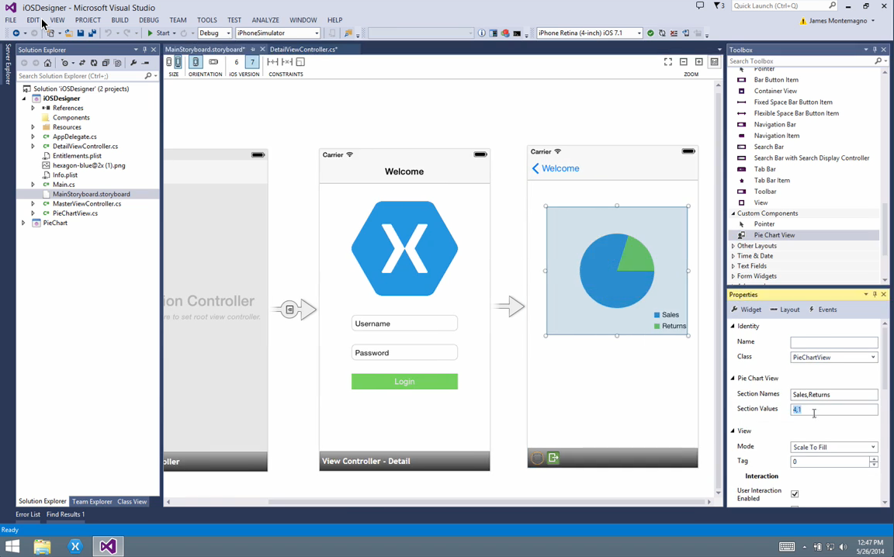
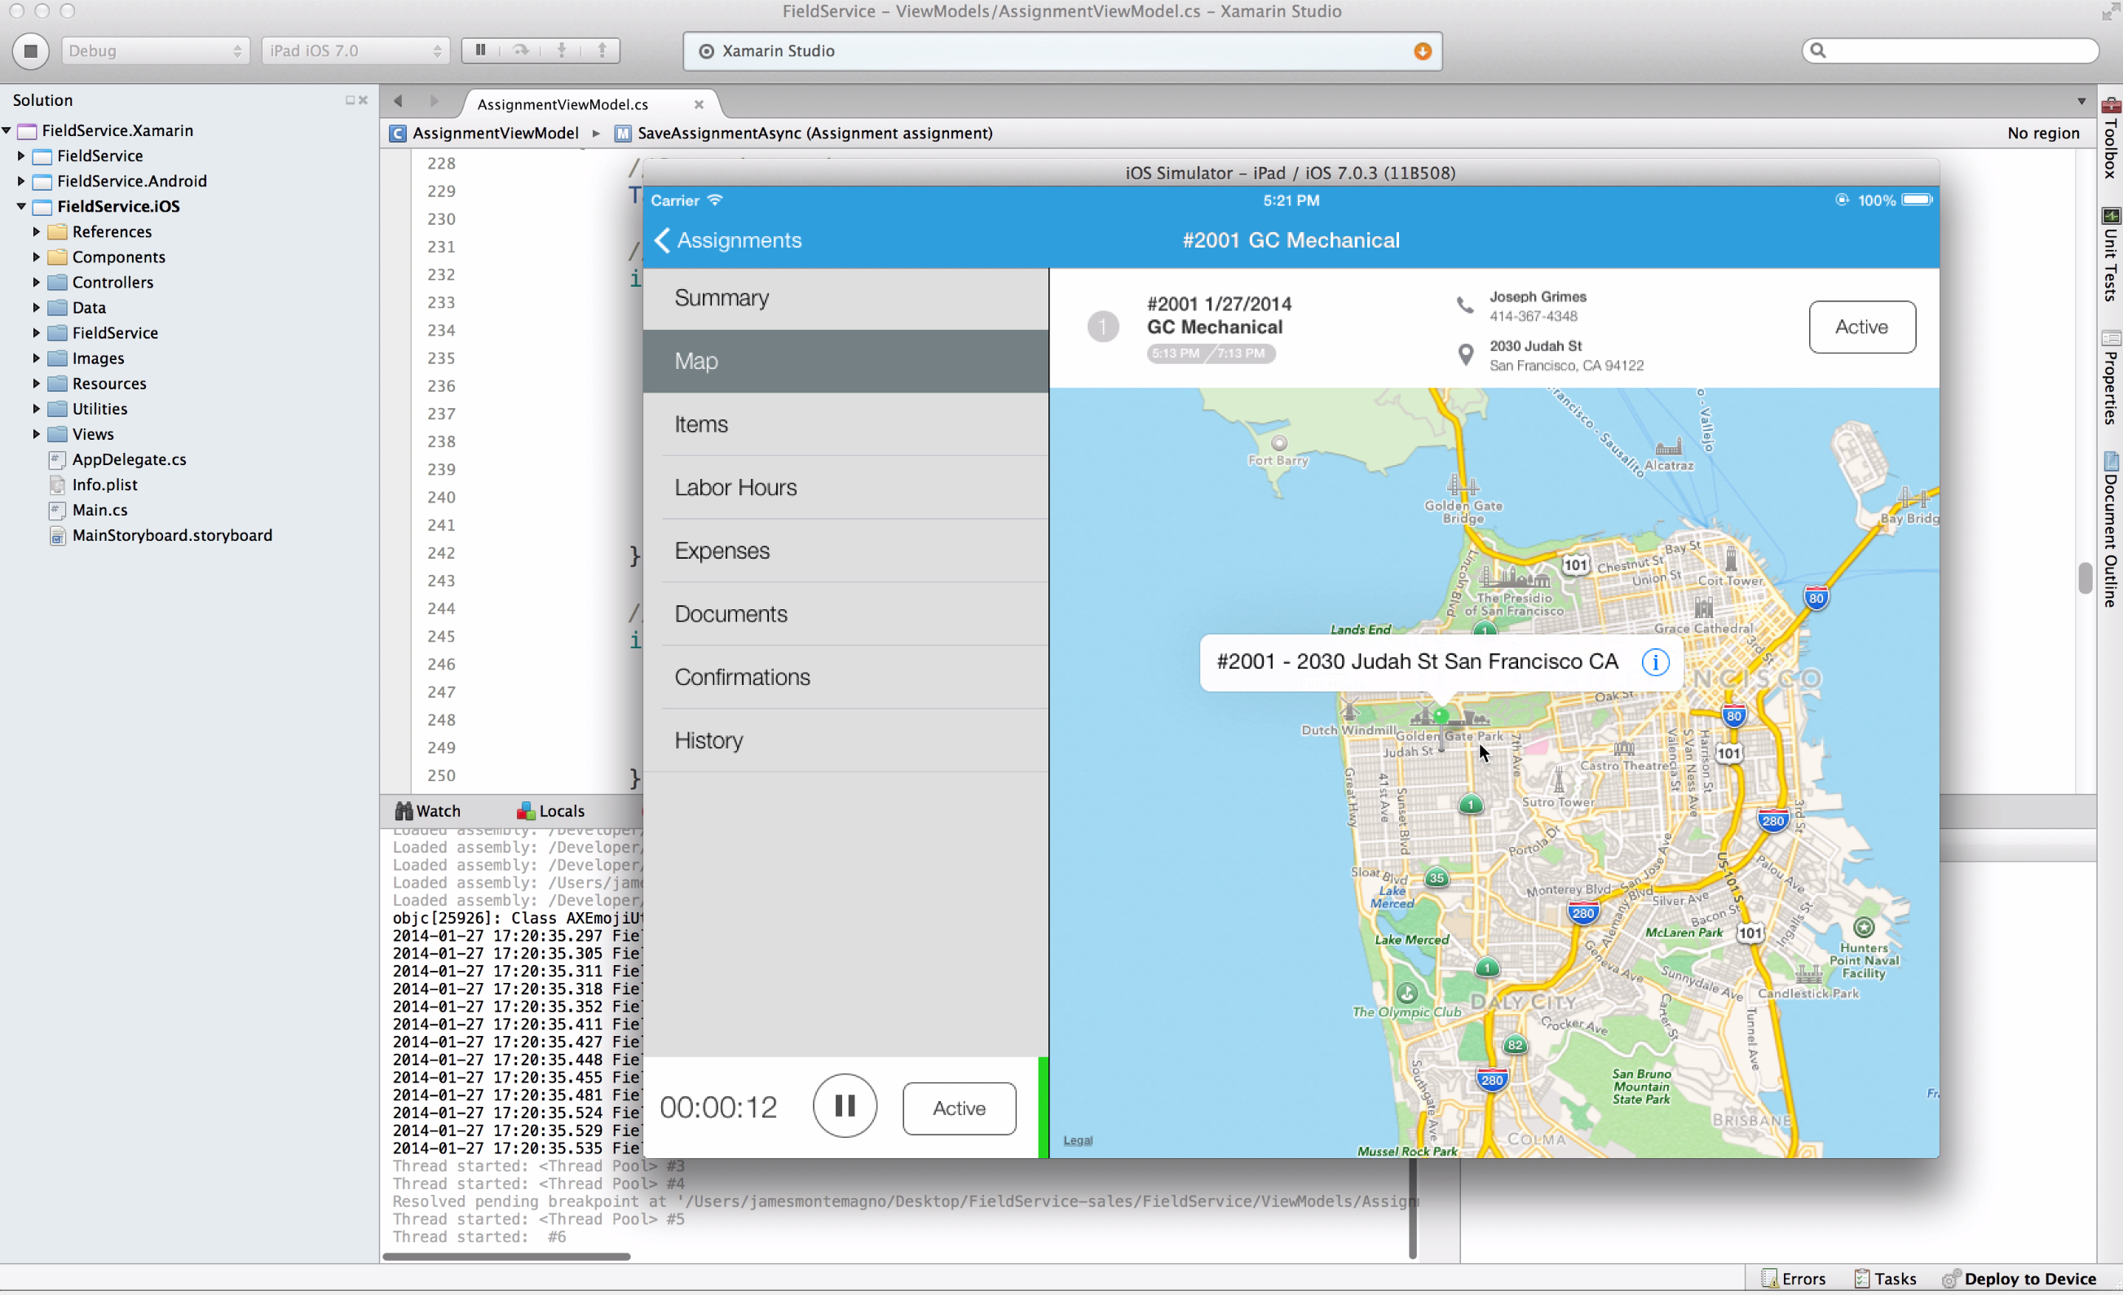
Xamarin for Visual Studio
Xamarin Studio

Slide 27
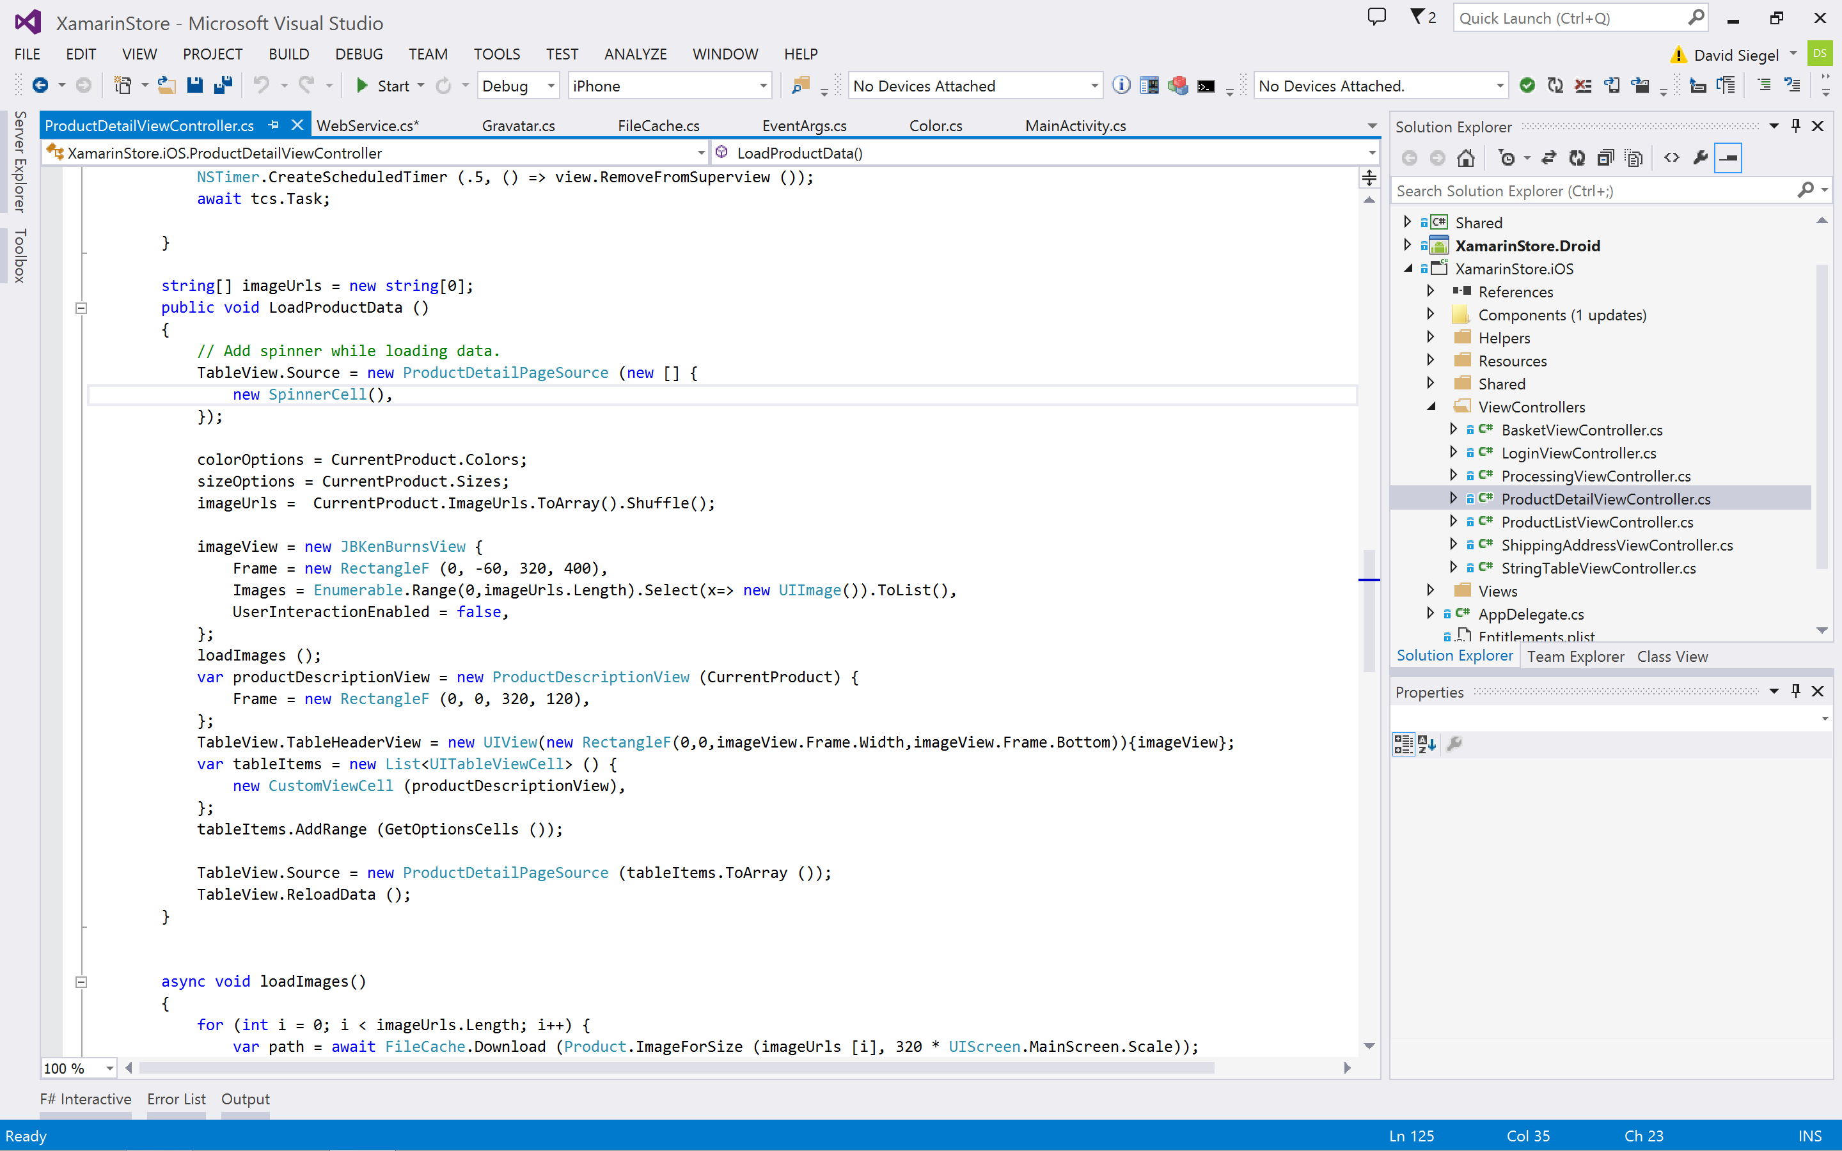
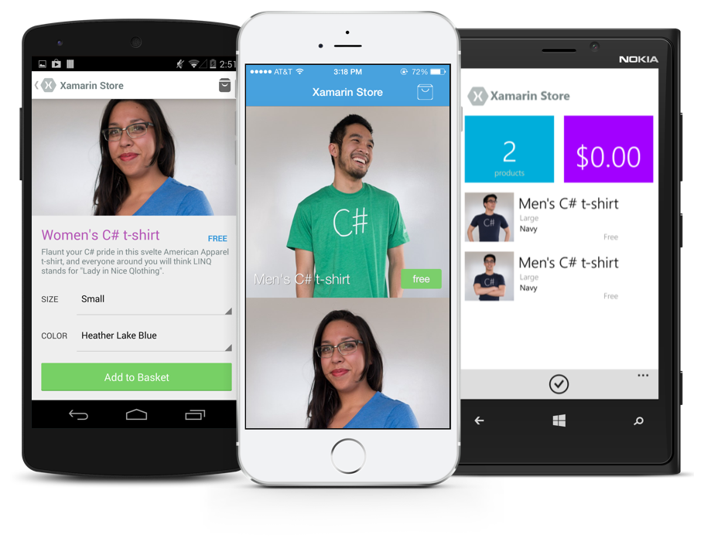
Anything you can do in Objective-C, Swift, or Java can be done in C# and Visual Studio with Xamarin
Notes:
..
But what if you could take this further, think about writing a native UI that can then share that too.
Maybe you’re building

Slide 28
Meet Xamarin.Forms
Build native UIs for iOS, Android, and Windows from a single, shared C# codebase.
Notes:
And that’s why we build Xamarin.Forms cross-plat UI abstraction that enables you to create cross-plat UI in XAML that is shared across all the different platforms
But still create and lay down all the native controls

Slide 29
Xamarin development approaches
iOS C# UI
Android C# UI
Windows C# UI
Xamarin.Forms
Shared C# Logic
Shared C# Logic
Traditional Xamarin approach
With Xamarin.Forms: More code-sharing, all native
Notes:
You still get access to all the native APIs

Slide 30
What’s included
✓ 40+ Pages, layouts, and controls
(Build from code behind or XAML)
✓ Two-way data binding
✓ Navigation
✓ Animation API
✓ Dependency Service
✓ Messaging Center
Xamarin.Forms
Shared C# Logic

Slide 31
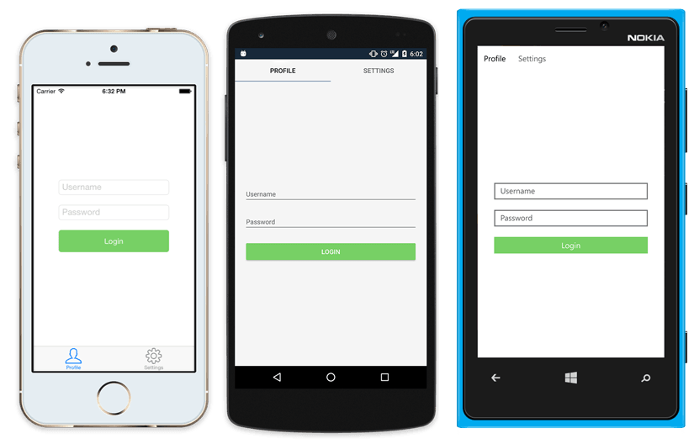
Native UI from shared code
<?xml version="1.0" encoding="UTF-8"?>
<TabbedPage xmlns="http://xamarin.com/schemas/2014/forms"
xmlns:x="http://schemas.microsoft.com/winfx/2009/xaml"
x:Class="MyApp.MainPage">
<TabbedPage.Children>
<ContentPage Title="Profile" Icon="Profile.png">
<StackLayout Spacing="20" Padding="20"
VerticalOptions="Center">
<Entry Placeholder="Username"
Text="{Binding Username}"/>
<Entry Placeholder="Password"
Text="{Binding Password}"
IsPassword="true"/>
<Button Text="Login" TextColor="White"
BackgroundColor="#77D065"
Command="{Binding LoginCommand}"/>
</StackLayout>
</ContentPage>
<ContentPage Title="Settings" Icon="Settings.png">
<!-- Settings -->
</ContentPage>
</TabbedPage.Children>
</TabbedPage>
Notes:
Now what that looks like is like this.
What we have there is a tabbed page, with a stack layout and that Login button has some green bg with a binding with Login Command.

Slide 32
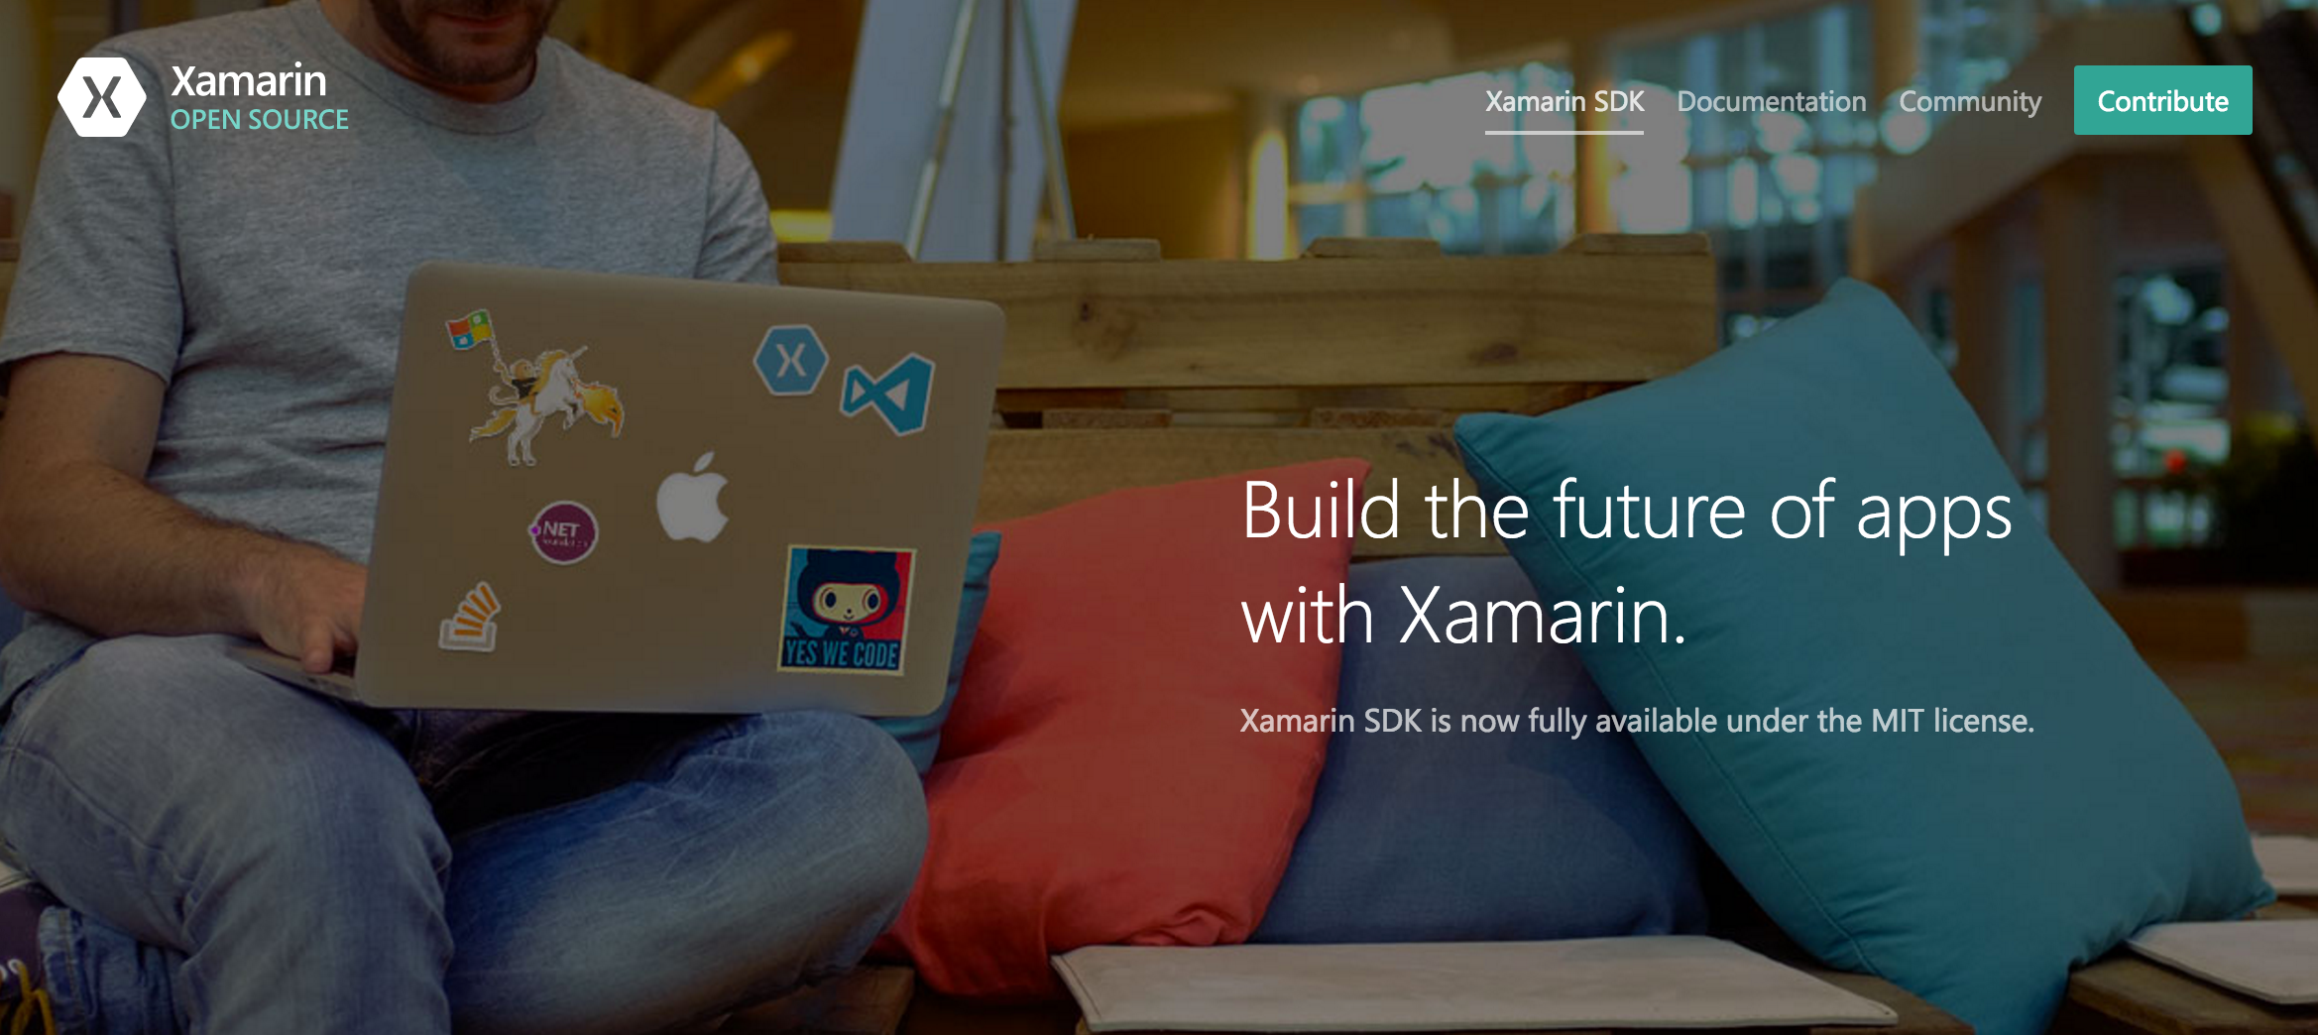
Open source—open.xamarin.com

Slide 33
Download Resources
https://aka.ms/WoXGitHub

Slide 34
Azure

Slide 35


























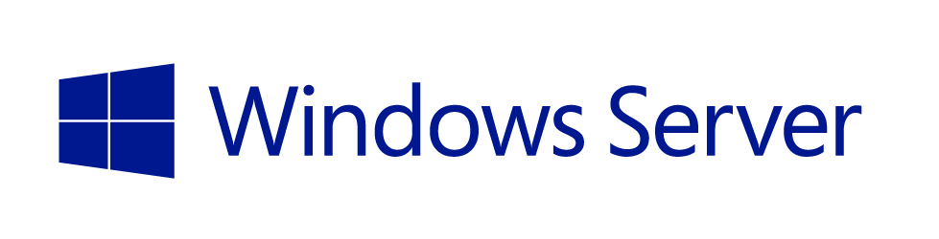
DevOps
Applications
Choice + Flexibility
App Frameworks
Databases & Middleware
Infrastructure

Slide 36

38
Azure regions around the world
More than AWS and Google Cloud combined

Slide 37


Slide 38


Slide 39
Platform services
Web + Mobile Internet of Things
Microservices
Data + Analytics
Identity Management
Media Streaming
High Performance Compute
Cognitive Services
Microsoft Azure
Hybrid
Core infrastructure
Compute Storage Networking Security

Slide 40
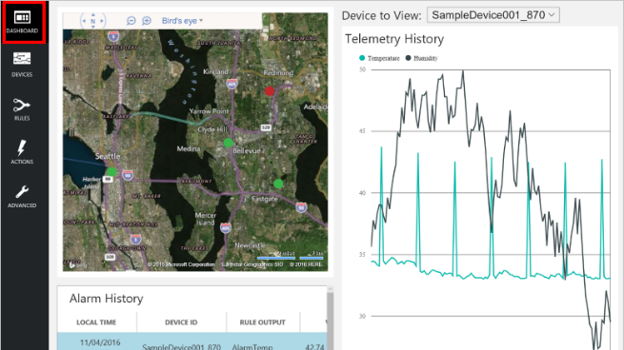
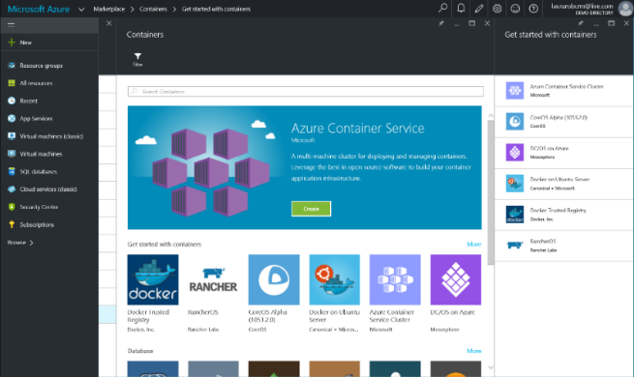
Build apps faster and easier
Build on PaaS
Azure
Internet of Things
Azure Marketplace
Existing frameworks
Web and mobile
Microservices
Serverless Compute
Build on IaaS
Virtual machines
Storage
Networking
Notes:
Building apps faster and easier means using the right building blocks for the job.
Starting from the bottom left, our core building blocks are storage, computing, and networking, or Infrastructure-as-a-Service, which provides customers with agility and cost savings.
When you add our integrated platform services, which run IaaS on the back-end, customers accelerate that agility. A recent study showed that customers using our platform as a service for app dev estimate 466% ROI than on just IaaS alone. This includes services across apps both small and internet-scale, data, integration, and so on.
In the middle, we’re packaging up services and capabilities to deliver preconfigured solutions such as with Azure IoT Suite. IoT is not a new concept in our industry, but it is extraordinarily difficult to deliver and maintain. In the past several years, the technology required to facilitate IoT solutions has improved dramatically, making it more accessible across industries and scenarios. Our IoT preconfigured solutions aim to further amplify that momentum, allowing companies to get to a working proof of concept in a fraction of the time than if they were building with individual components from scratch.
Finally, you can leverage full templates for web, mobile, containers, etc.--both first and third party--to get started in minutes rather than hours and days, through the Azure Marketplace. The screenshot here is our gallery of container templates, ranging from Docker to Mesosphere.

Slide 41
































































Platform Services
Security & Management
Hybrid
Cloud
Media & CDN
Application Platform
Data
Security Center
SQL
Database
Azure AD
Health Monitoring
Media Services
Media Analytics
Content Delivery
Network
Web
Apps
Mobile
Apps
SQL Data
Warehouse
DocumentDB
Portal
AD Privileged
Identity
Management
Azure Active
Directory
Integration
SQL Server
Stretch Database
Redis
Cache
Storage
Tables
Azure
Search
API
Apps
Cloud
Services
Azure AD
B2C
API
Management
BizTalk
Services
Domain Services
Service
Fabric
Notification
Hubs
Intelligence
Multi-Factor
Authentication
Logic
Apps
Service Bus
Functions
Cognitive Services
Bot Framework
Cortana
Backup
Automation
Developer Services
Analytics & IoT
Operational
Analytics
Compute Services
Scheduler
HDInsight
Machine
Learning
Stream Analytics
Container
Service
VM
Scale Sets
Visual Studio
Mobile
Engagement
Import/Export
Key Vault
Data
Catalog
Data Lake
Analytics Service
Data Lake Store
Store/
Marketplace
Batch
RemoteApp
VS Team Services
Xamarin
Azure Site
Recovery
Application
Insights
HockeyApp
IoT Hub
Event
Hubs
Data
Factory
Power BI
Embedded
VM Image Gallery
& VM Depot
Dev/Test Lab
StorSimple
Infrastructure Services
Compute
Storage
Networking
Virtual Machines
Containers
Blob
Queues
Files
Disks
Virtual Network
Load Balancer
DNS
Express
Route
Traffic Manager
VPN Gateway
App
Gateway
Datacenter Infrastructure (32 Regions, 24 Online)
Notes:
Why this Slide:
It shows we have a very broad platform. It about BOTH IaaS and PaaS, that these work together. It shows that we continue to lead in world class IT capabilities and that there’s really nothing missing.
Key Points:
We have already seen how the Azure Platform is IaaS + Pass – but I want you to understand that this is a huge number of capabilities – IT building blocks if you will.
Every one of these blocks you provision anytime, self-service anywhere in the world 24x7. You pay for what you use, you can get more or less anytime and you can fully automate everything…
DON’T spent too much time on this slide – you are going to DEMO (aren’t you!!!)… DON’T go through each block…
Transition to NEXT Slide: Make the build go backwards to show JUST IaaS and then you will go to the demo to show it.

Slide 42
Demo
Azure Portal

Slide 43
Thank You!
Vishesh Oberoi
Technical Evangelist, Microsoft
@ovishesh visho@microsoft.com

